Slide 1
Processor Design
5Z032
Chapter 8
Interfacing Processors and Peripherals
Henk Corporaal

Slide 2
Topics
Introduction
I/O how?
I/O devices
  Examples
Buses

Slide 3
Introduction
I/O Design affected by many factors (expandability, cost, performance, standards, availability)
Performance:
— access latency
— throughput
— connection between devices and the system
— the memory hierarchy
— the operating system

Slide 4
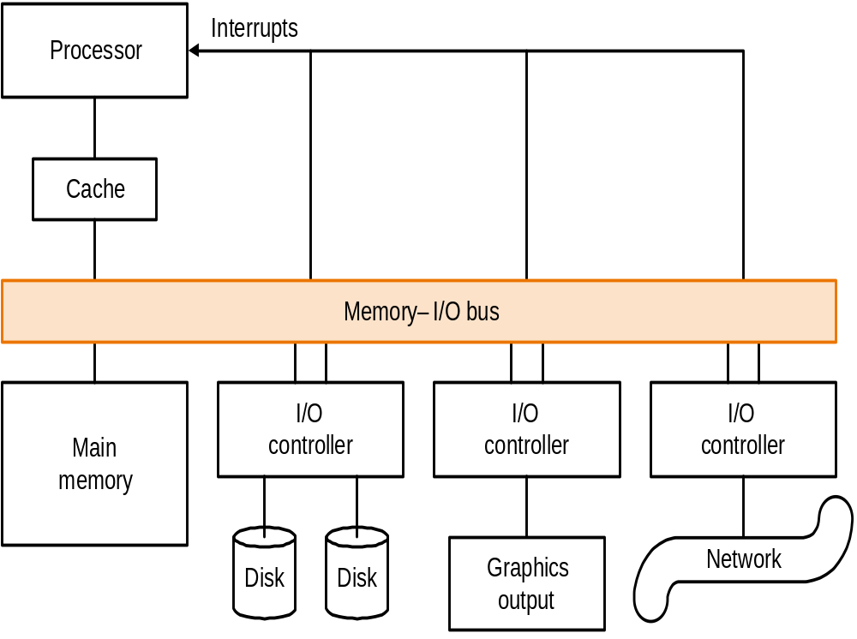
Input-Output (I/O): how
Typical collection of I/O devices

Slide 5
I/O
Important but neglected
“The difficulties in assessing and designing I/O systems have
often relegated I/O to second class status”
“courses in every aspect of computing, from programming to
computer architecture often ignore I/O or give it scanty coverage”
“textbooks leave the subject to near the end, making it easier
for students and instructors to skip it!”
We won’t be looking at I/O in much detail

Slide 6
I/O example
Assume current application requires:
  90 seconds CPU time
  10 seconds I/O time
What will happen in 5 years if CPUs get faster 50% each year but I/O performance stays constant
Answer:
  CPU time reduces to 22 seconds
  I/O time increases from 10% to 45% !!!

Slide 7
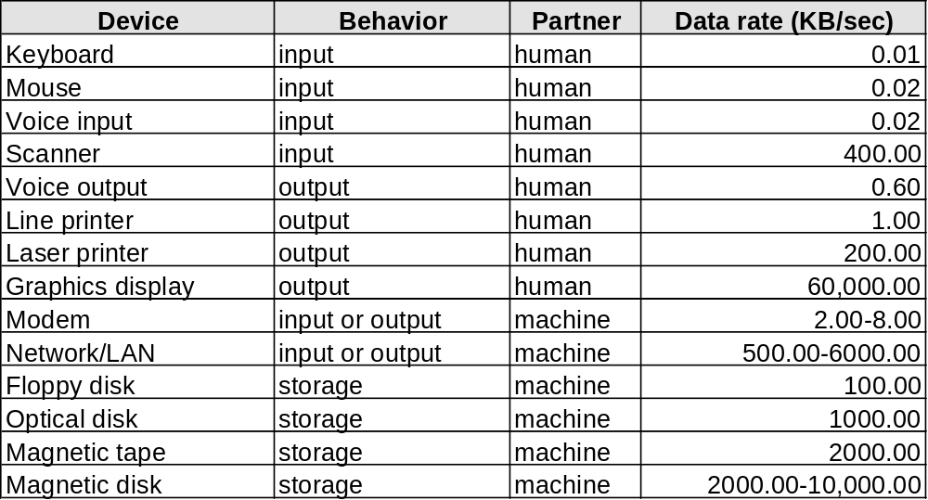
I/O Devices
Very diverse devices
— behavior (i.e., input vs. output)
— partner (who is at the other end?)
— data rate

Slide 8
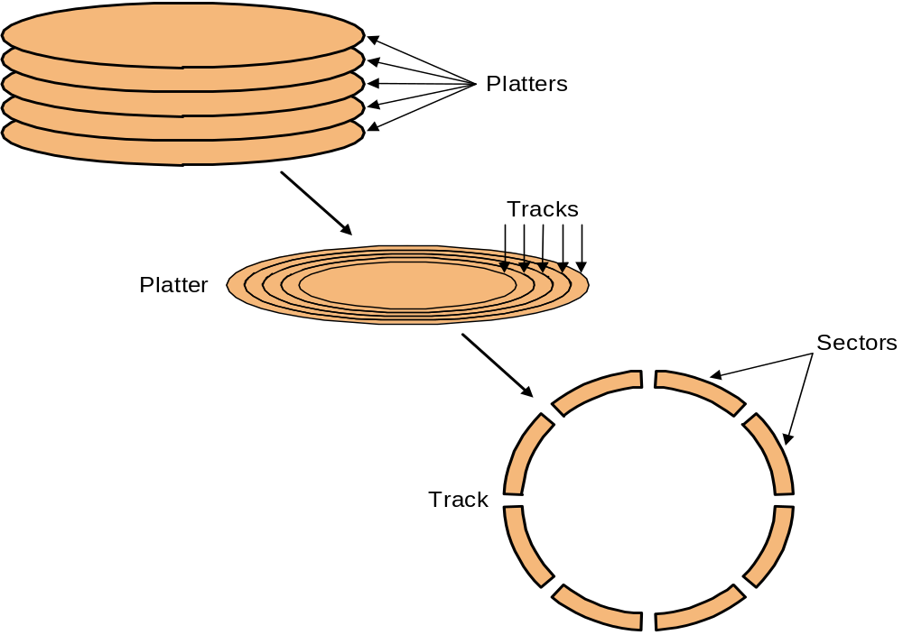
I/O Example: Disk Drives
To access data:
— seek: position head over the proper track (8 to 20 ms. avg.)
— rotational latency: wait for desired sector (.5 / RPM)
— transfer: grab the data (one or more sectors) 2 to 15 MB/sec
RPM=
rotations per minute

Slide 9
I/O Example: Buses
Shared communication link (one or more wires)
Difficult design:
— may be bottleneck
— length of the bus
— number of devices
— tradeoffs (buffers for higher bandwidth increases latency)
— support for many different devices
— cost
Types of buses:
— processor-memory (short high speed, custom design)
— backplane (high speed, often standardized, e.g., PCI)
— I/O (lengthy, different devices, standardized, e.g., SCSI)
Synchronous vs. Asynchronous
— use a clock and a synchronous protocol, fast and small
but every device must operate at same rate and
clock skew requires the bus to be short
— don’t use a clock and instead use handshaking

Slide 10
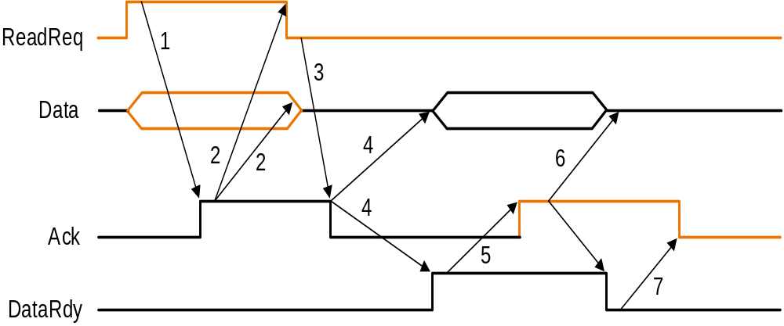
Some Example Problems
Look at some examples from the text
“Performance Analysis of Synchronous vs. Asynchronous”
“Performance Analysis of Two Bus Schemes”

Slide 11
Study from the book:
Bus Arbitration:
— daisy chain arbitration (not very fair)
— centralized arbitration (requires an arbiter), e.g., PCI
— self selection, e.g., NuBus used in Macintosh
— collision detection, e.g., Ethernet
Operating system:
— polling
— interrupts
— DMA
Performance Analysis techniques:
— queuing theory
— simulation
— analysis, i.e., find the weakest link (see “I/O System Design”)

